Slide 1
Using Similarity in Supervised Learning
MSCI:6070 Data Science
Lazy Learner:
K-Nearest Neighbors
Notes:
hm2 tree

Slide 2
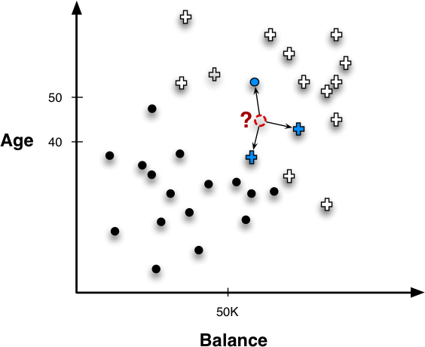
Nearest Neighbors for Predictive Modeling
Similarity in predictive modeling:
Given a new example, we find similar ones in the training example and predict the new example’s target value based on the nearest neighbors’ (known) target values
Similar examples are those that have small distances to the new example

Slide 3
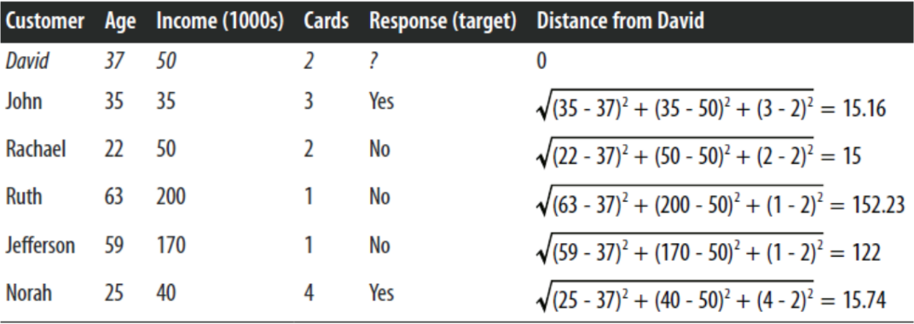

Nearest Neighbors for Classification
Target Variable
Who’s David’s nearest neighbor?
Things we need to consider
How many neighbors? (k = ?)
How to combine their labels? (e.g., majority vote)
Vary the influence of neighbors based on distance?
Notes:
Why three neighbors instead of just one or 5?

Slide 4
Nearest Neighbors in Classification - how many neighbors?
k-NN
Nearest neighbor algorithm that uses k neighbors
k is a complexity parameter: the greater k is the more the estimates are smoothed out among neighbors
Output of k-NN
k and all training data
Q: What happens if you choose k = n, where n is the size of the entire training set?
Notes:
compare with logistic regression and sVm

Slide 5
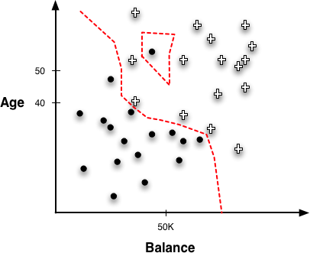
K Nearest Neighbors
How to draw a decision boundary?
no explicit boundary is created, but there are implicit regions created by instance neighborhoods. There regions can be calculated by systematically probing points in the instance space, determining each point’s classification, and constructing the boundary where classifications change.
Q: What is the training error of a 1-NN model?
1-NN
Can you draw the draw decision boundary for 1-NN?
sensitive to noise/outliers
Notes:
negative island; considered noise or an outlier
It’s own value will be used to predict its label
Draw decision boundary
Relate it to SVM

Slide 6
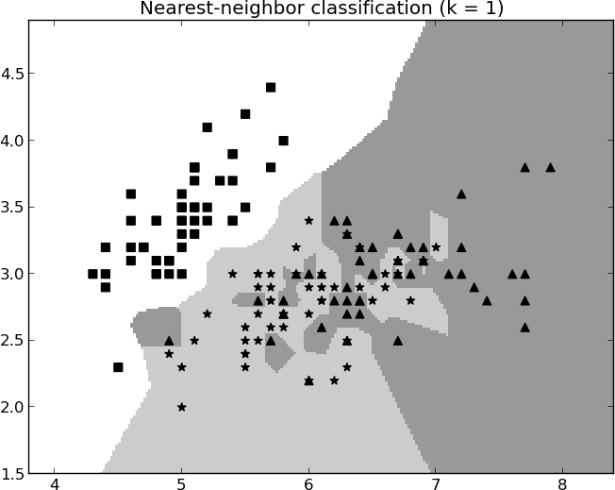
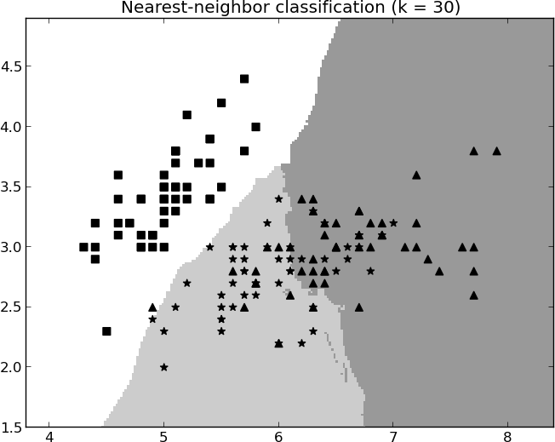
Decision Boundary of K Nearest Neighbors
k is a complexity parameter
Q: Is a smaller or greater k likely to overfit the data (i.e., has a overly complicated decision boundary)?
3-class classification
a bigger k is robust to noise/outliers
Notes:
k=30: much less jagged

Slide 7
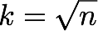
Finding the Best K
How to choose k?
A good rule of thumb
Cross-validation
Split the data into training and validation sets.
Split the training set into 5 (or 10, etc.) folds (partitions). Each time, use data from four folds to classify the remaining fold. Rotate the choice of four folds so as to repeat 5 times.
The best value of k* is defined to be the one that resulted in the smallest average error rate.
Recombine the 5 folds back into one dataset. Use k* and this dataset to classify the observations in the validation data and determine the out-of-sample error rate.

Slide 8
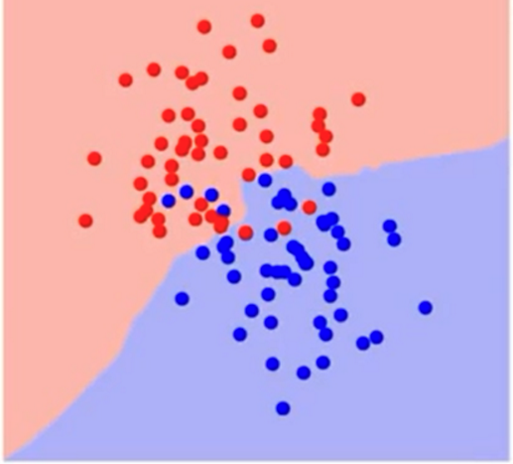
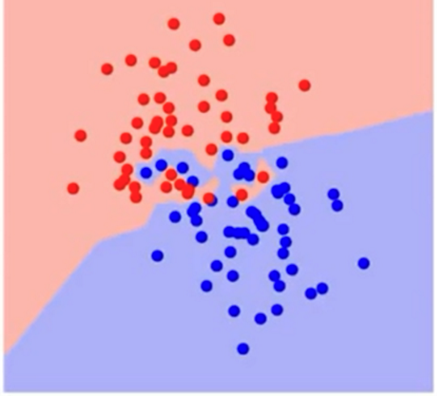
Practice
Assume 800 training and 200 test points and k is determined by 4-fold cross validation. During cross validation, when classifying a data point, how many distances need to be calculated? When tested on the test set, how many distances need to be calculated?
Which of the following has a larger K?

Slide 9
Strengths of k-NN models
Simple to implement and use
Robust to noisy data
Comprehensible - easy to explain prediction

Slide 10
Issues with Nearest-Neighbor Methods
Computation Efficiency
Training is fast because it usually involves only storing the instances, however:
Need a lot of space to store all examples
Takes more time to classify a new example
Difficult to explain the “knowledge” that has been mined from the data

Slide 11
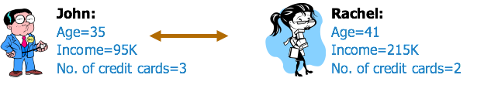
Issues with Nearest-Neighbor Methods
Dimensionality
Dominance of attributes
Solution: rescaling data to the same range or same distribution
Having too many / irrelevant attributes may confuse distance calculations -> curse of dimensionality
For example: each instance is described by 100 attributes out of which only 10 are relevant in determining the target variable. In this case, instances that have identical values for the 10 relevant attributes may nevertheless be distant from one another in the 100 dimensional instance space.
Solution: Feature selection
Distance (John, Rachel)=

Slide 12
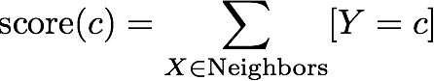

Some Important Technical Details
Combining Functions: Calculating Scores from Neighbors
Majority scoring function
k = 3
score( ) = 2
0
score( ) = 1
score( ) = 2

Slide 13
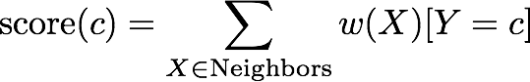
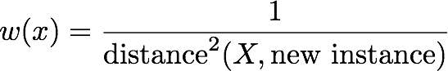
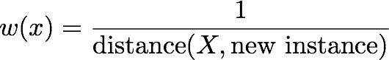
Variations of KNN
Combining Functions: Calculating Scores from Neighbors
Similarity-moderated classification
w(X) is a weighting function based on the similarity between X and the new instance. It is commonly modeled as
or
k = 3
2
1
score( ) =1/4 + 1/2.25 = 0.69
1.5
score( ) = 1

Slide 14
Nearest Neighbors in Probability Estimation
k = 3
probability( ) = ?
probability( ) = ?

Slide 15







Nearest Neighbors in Regression
k = 3
1.5
2
2.5

Slide 16
kNN Different Names
Memory-Based Reasoning
Example-Based Reasoning
Instance-Based Learning
Case-Based Reasoning
Lazy Learning
Defer the decision to generalize beyond the training examples till a new instance is encountered

Slide 17
Summary
Whenever we have a new point to predict, we find its K nearest neighbors from the training data.
Produces nonlinear decision boundaries
No model is built - simply looking up the nearest neighbors
Trivial to train (no training at all except figuring out K), slow to classify
Memory and CPU cost
Need to scale attributes

